Slide 1

Personal Protective Equipment (PPE)

Slide 2
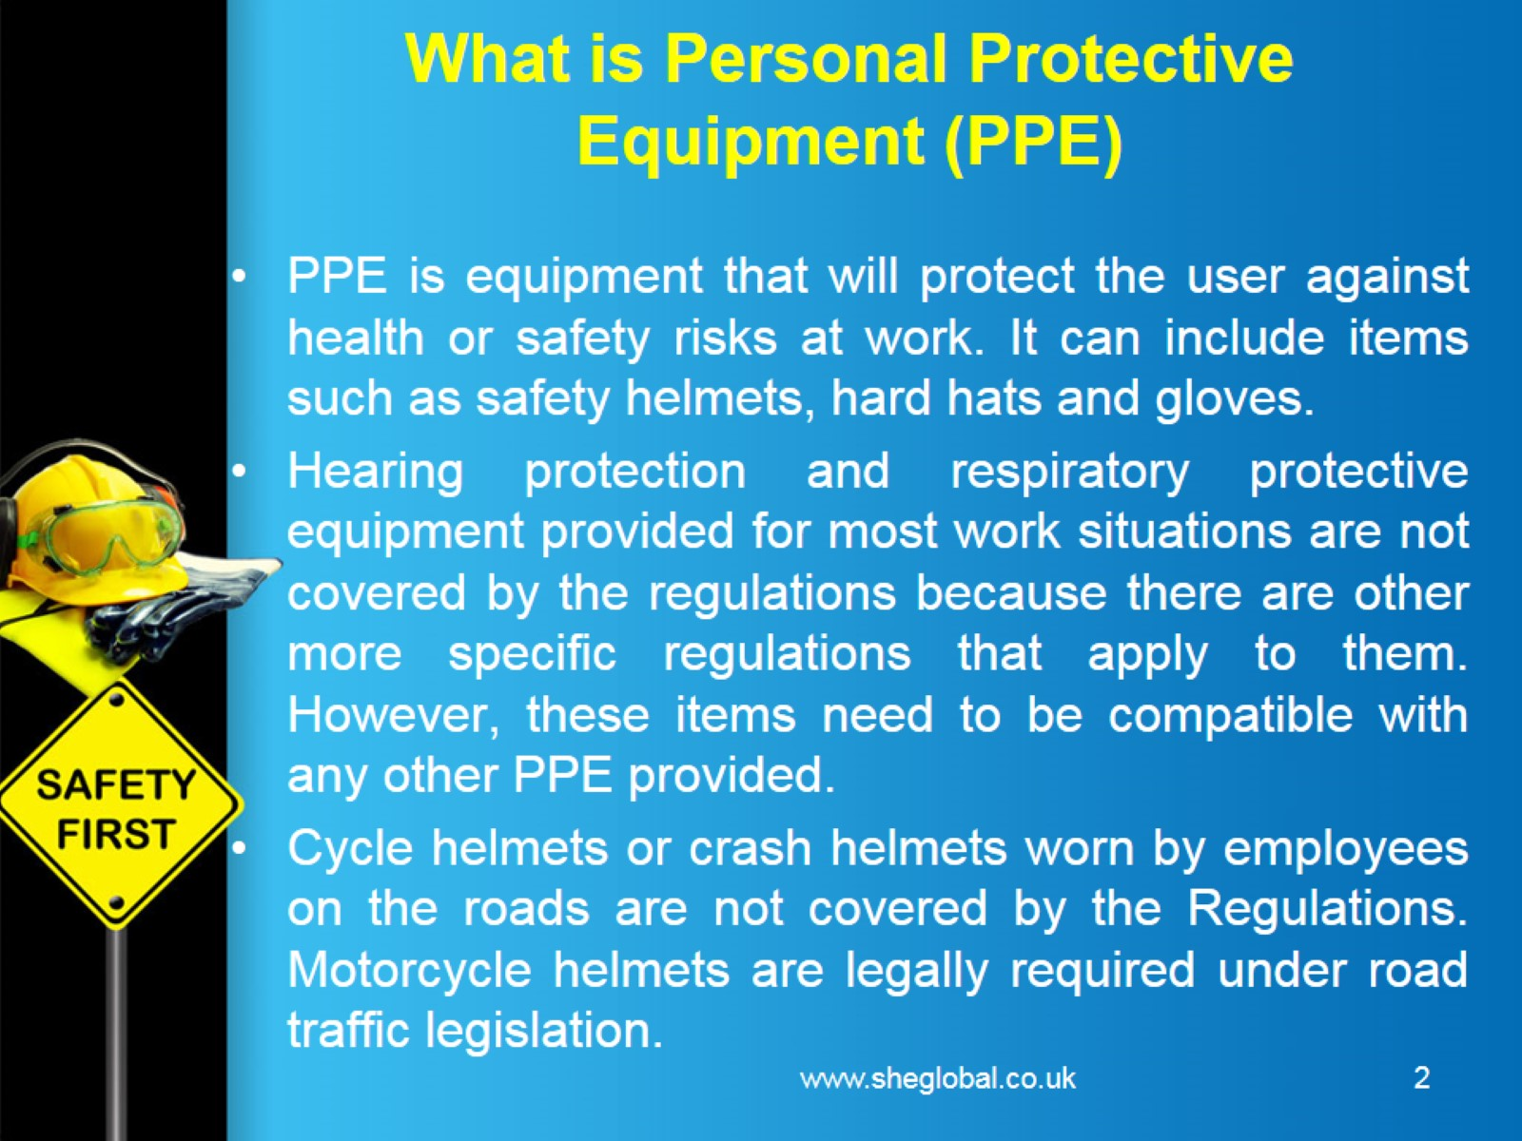
What is Personal Protective Equipment (PPE)

Slide 3
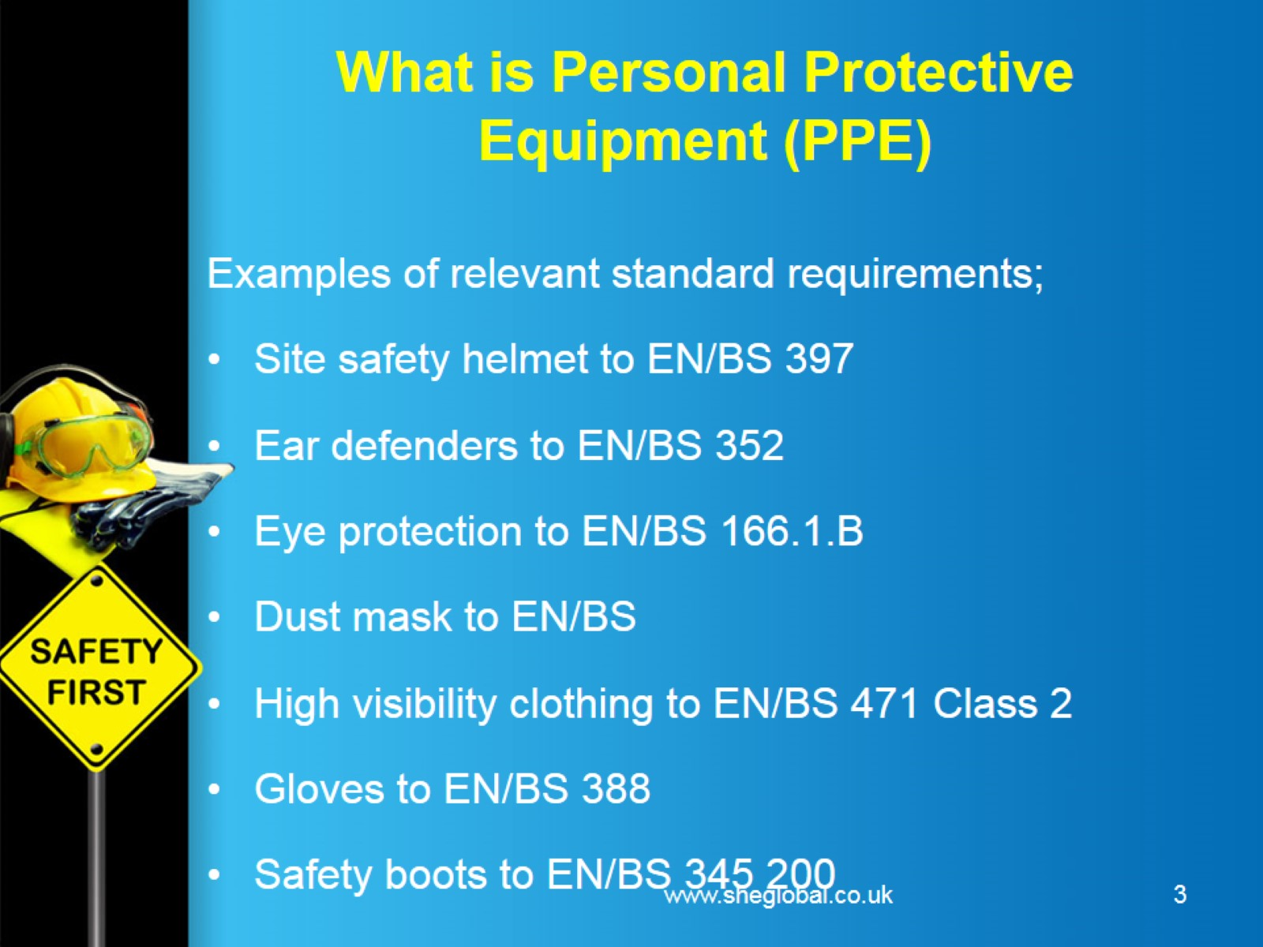
What is Personal Protective Equipment (PPE)

Slide 4
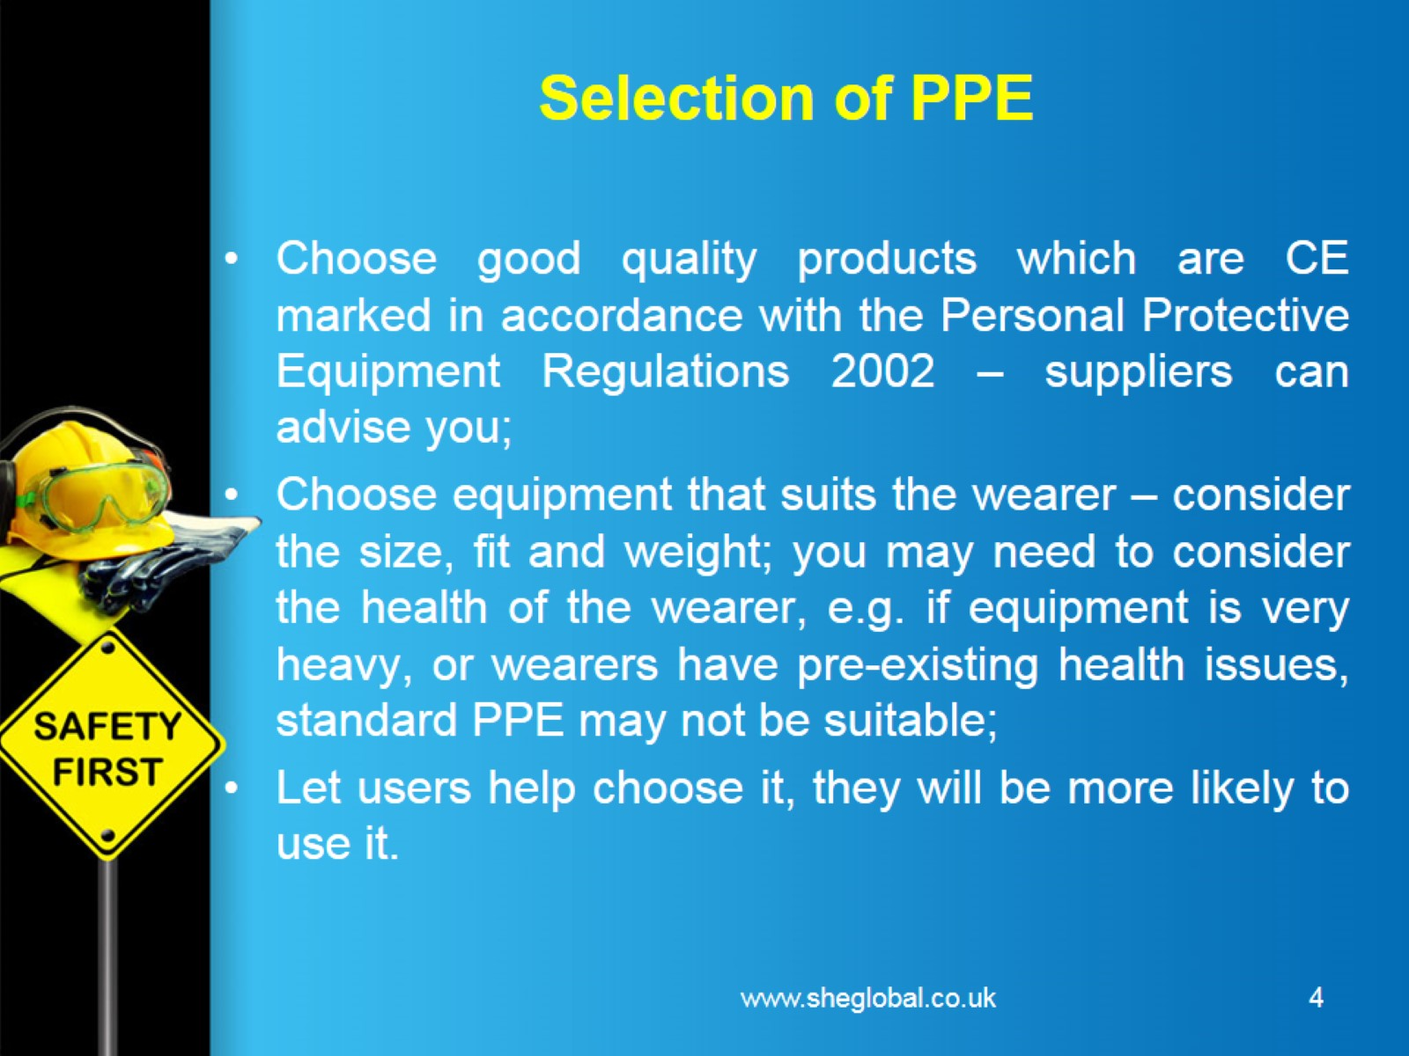
Selection of PPE

Slide 5
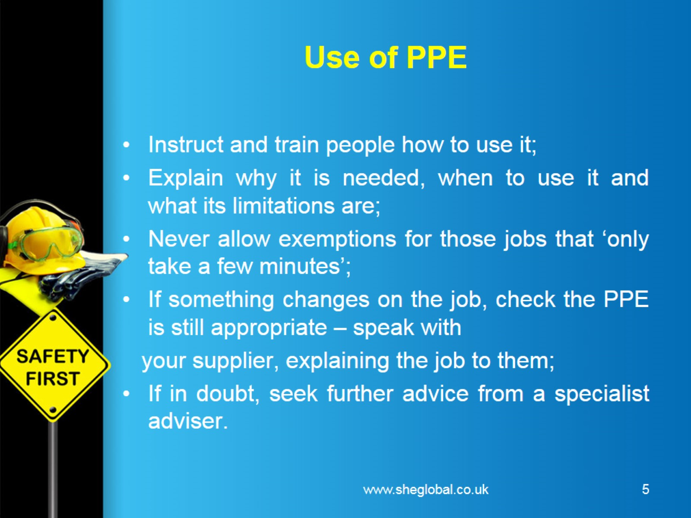
Use of PPE

Slide 6
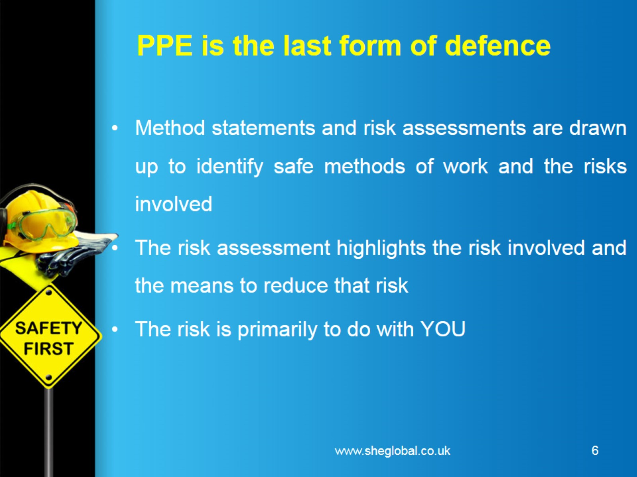
PPE is the last form of defence

Slide 7
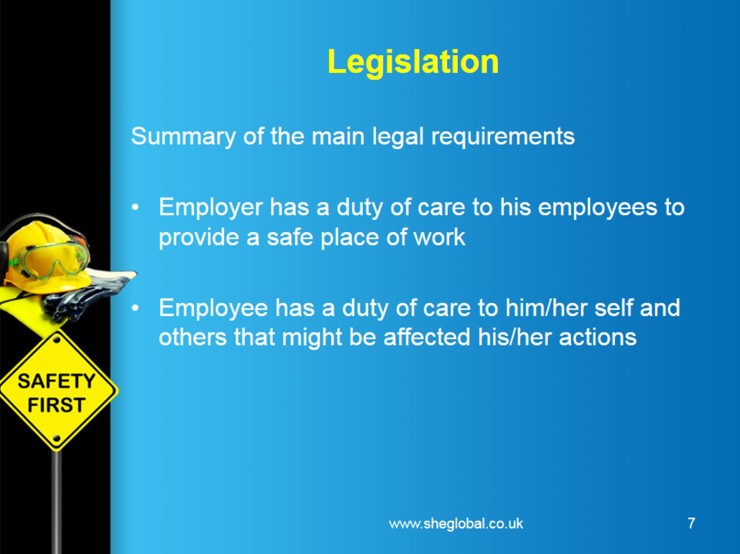
Legislation

Slide 8
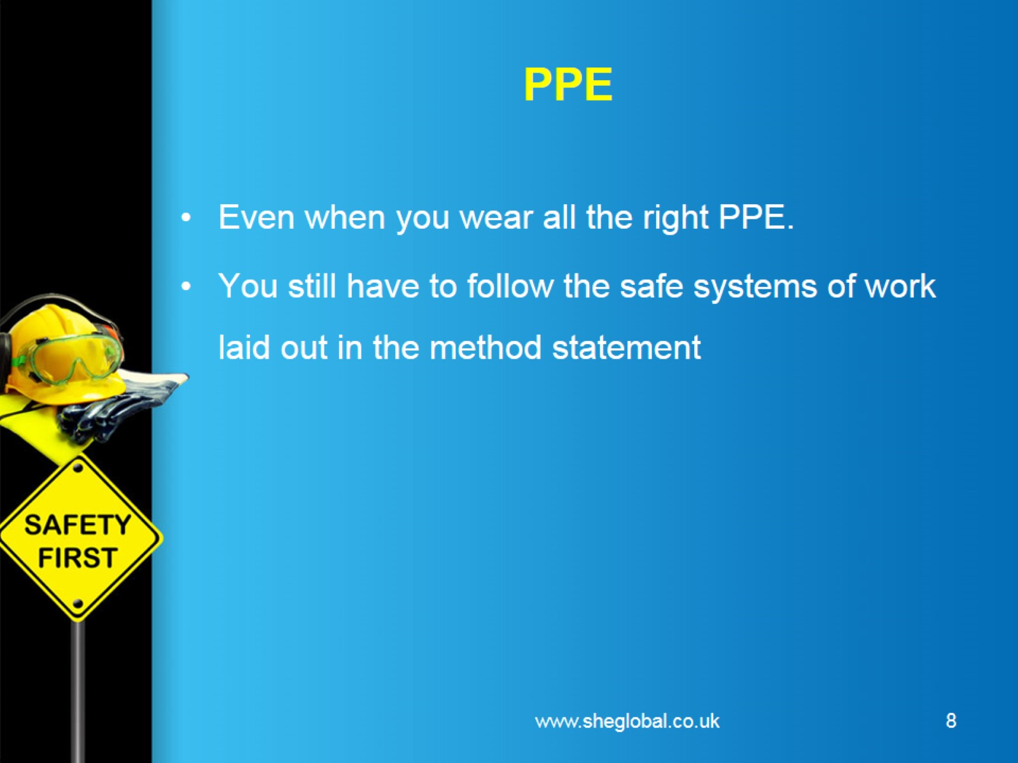
PPE

Slide 9
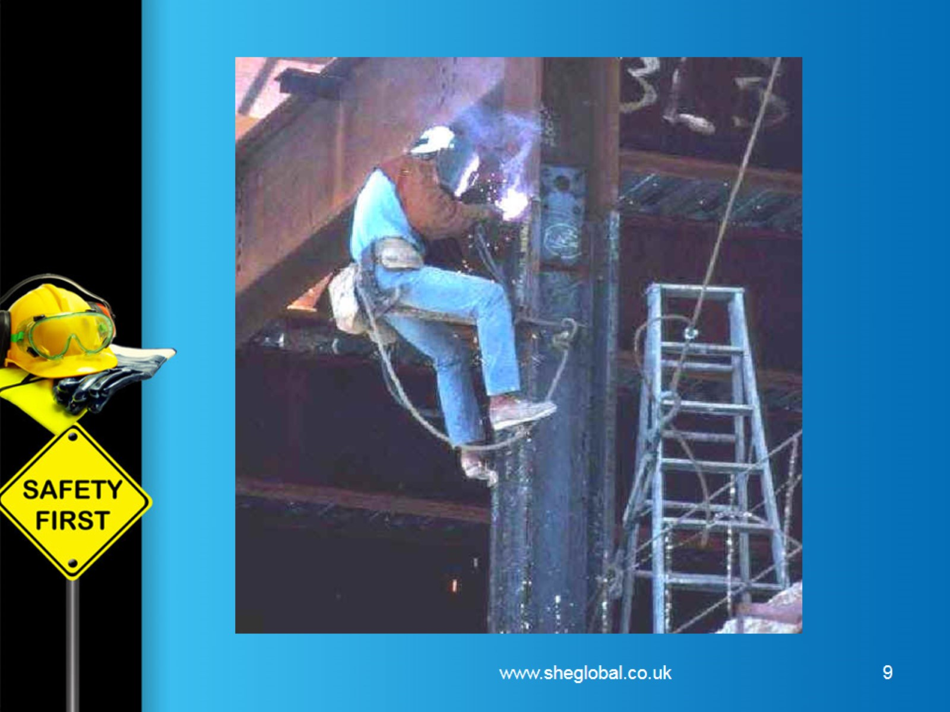

Slide 10
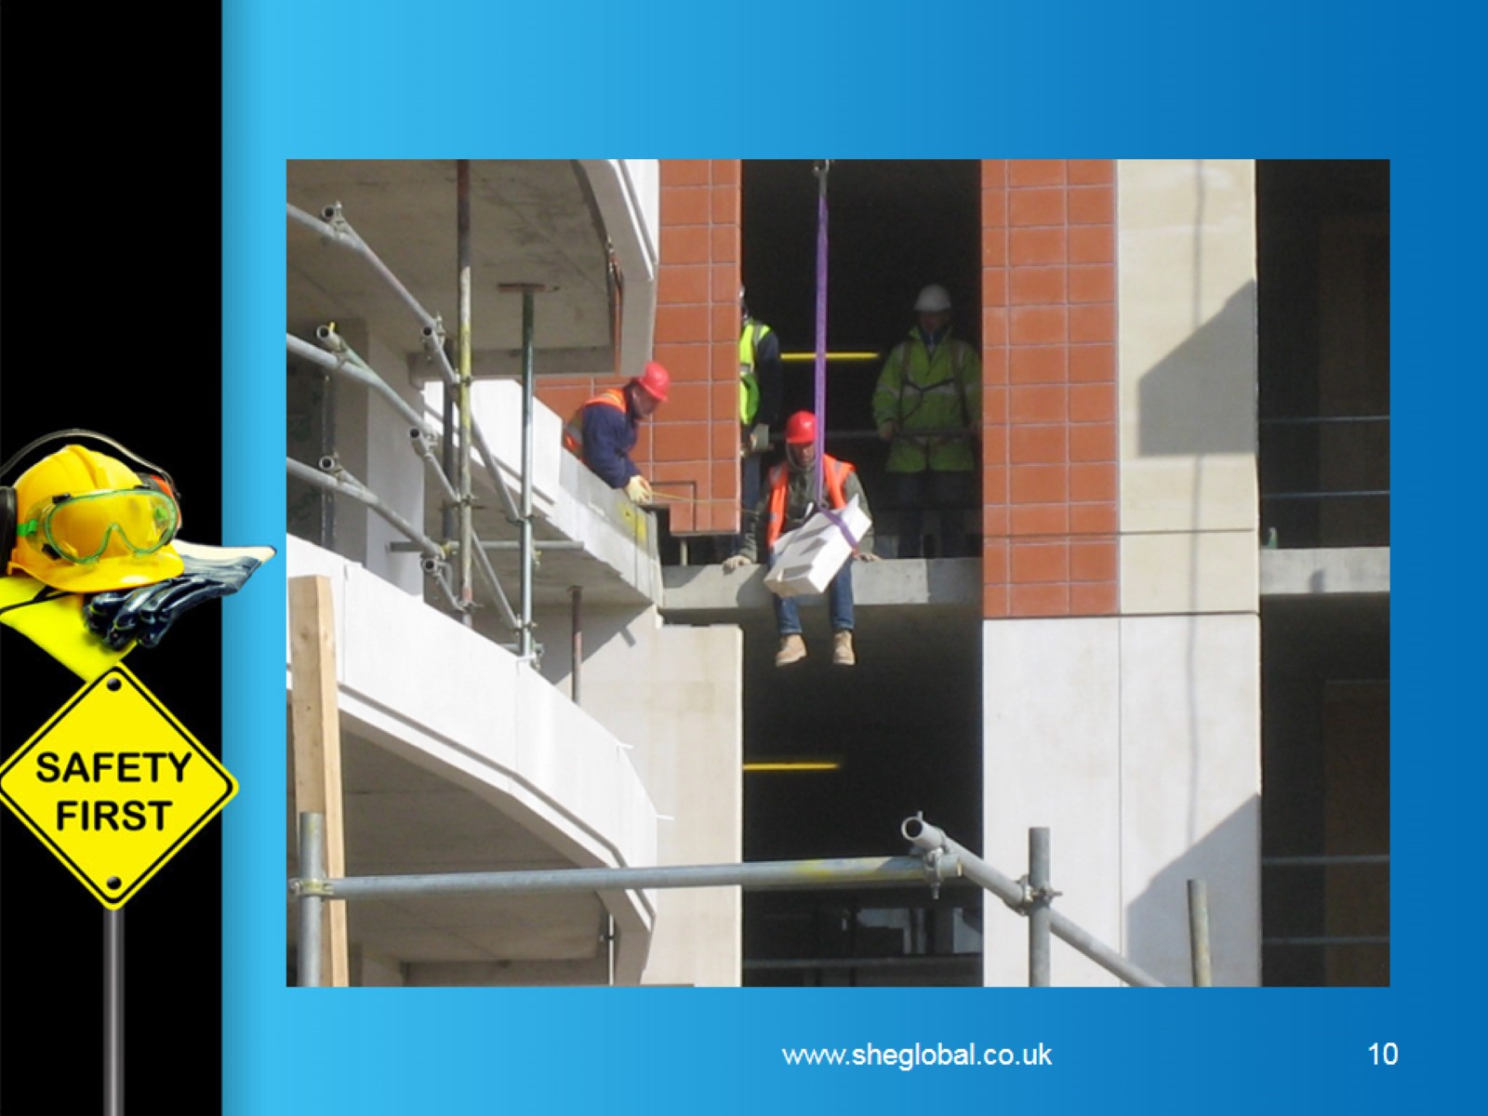

Slide 11
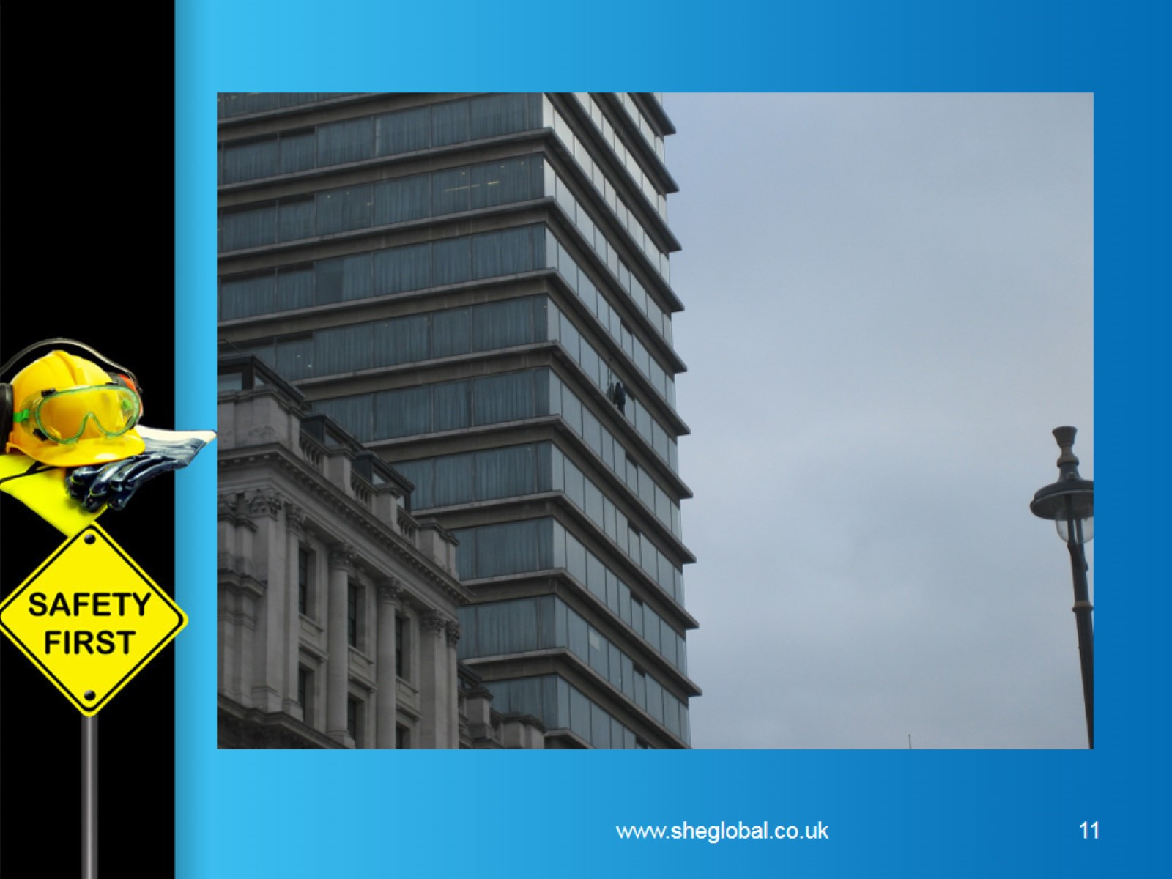

Slide 12


